Slide 1

10+ years of PowerShell: Where have we been? / Where are we going?
UK South Coast PowerShell User Group 23/05/2017
@jonathanmedd

Slide 2


Slide 3
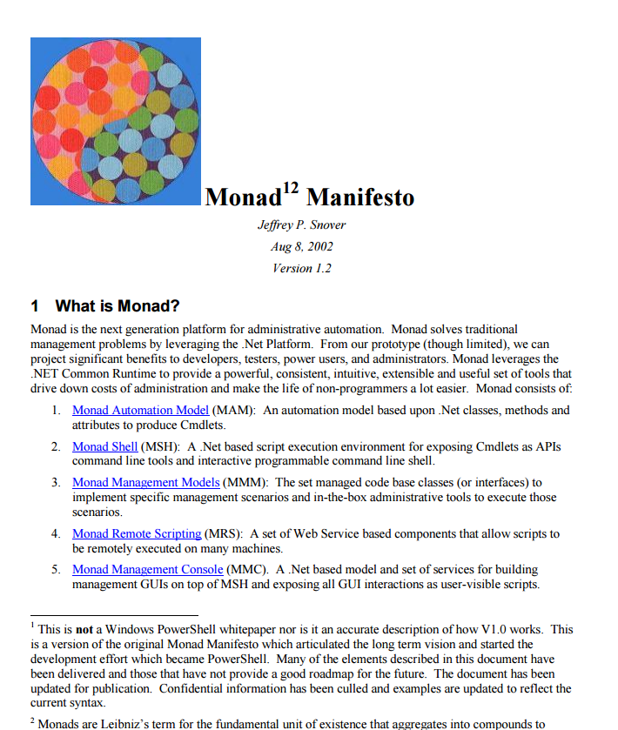
Monad Manifesto
http://www.jsnover.com/Docs/MonadManifesto.pdf

Slide 4
PowerShell Timeline
1.0
2.0
3.0
4.0
5.0
5.1
Nov 2006
July 2009
September 2012
October 2013
February 2016
August 2016
6.0 alpha
6.0 GA
Nov 7
Sep 2016
?????
Dec 20
2006
2006
2009
2011
2012
2013
2014
2015
2016
2017
2017
6 days
Today
18 days
24 days
16 days
25 days

Slide 5

1.0 – Nov 2006
Standalone download for Windows XP, Vista and Server 2003

Slide 6
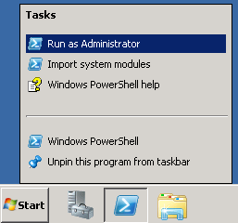
2.0 – July 2009
Yay we are in the OS! - Windows 7 and 2008 R2
Remoting
Background jobs
Advanced functions
Modules
ISE
Try-Catch-Finally
Comment Based Help

Slide 7
3.0 – September 2012
Windows 8 and Server 2012
Invoke-WebRequest, Invoke-RestMethod, ConvertTo/From-Json
Improved Remoting
Improved ISE
Help documentation could be updated out of band with Update-Help
That was controversial at the time!
Module AutoLoading

Slide 8
4.0 – October 2013
Windows 8.1 and Server 2012 R2
PowerShell DSC
Where and ForEach methods
Save-Help

Slide 9
5.0 – February 2016
PowerShell Classes
Improved DSC

Slide 10
5.1 – August 2016
Windows 10 Anniversary Update and Server 2016
Two editions:
Desktop – traditional with full fat .NET Framework
Core - runs on .NET Core and bundled with Server 2016 Nano Server
Local accounts module

Slide 11
Some of the following slides have been stolen…..

Slide 12
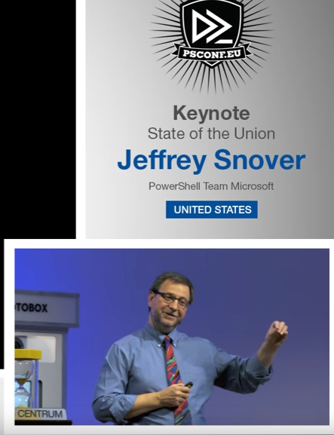
https://www.youtube.com/watch?v=myQkHM_je70&index=2&list=PLDCEho7foSooHYGxYqUj2Q6C7usp4aKIQ

Slide 13
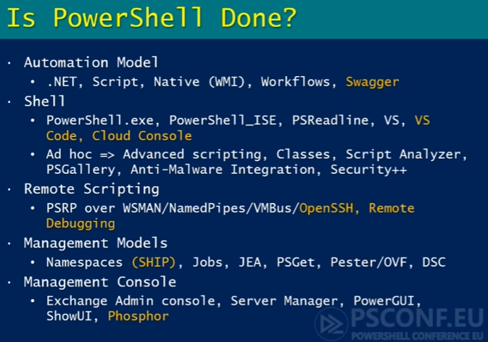

Slide 14
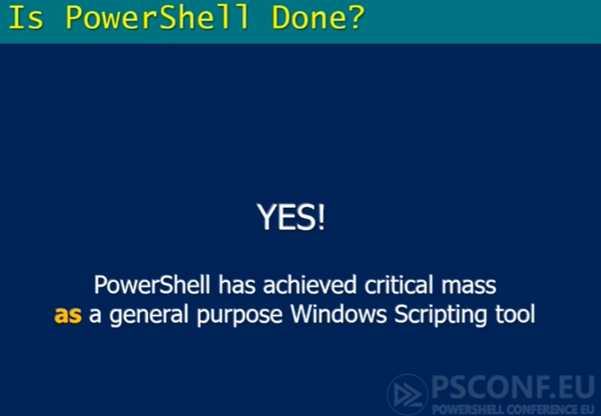

Slide 15
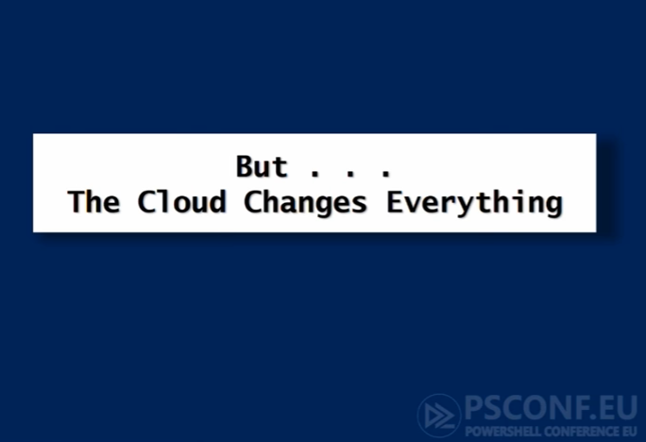

Slide 16
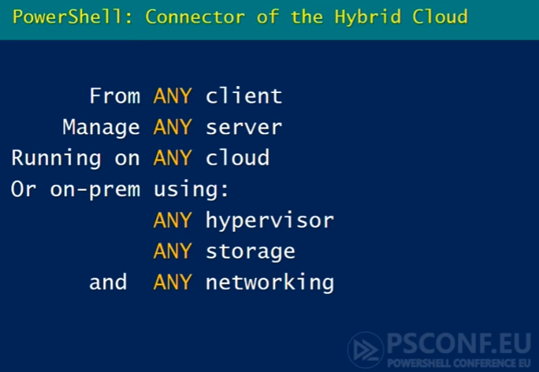

Slide 17

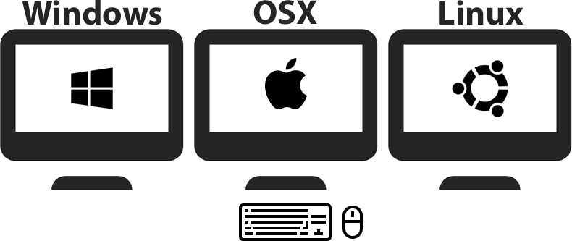
6.0 alpha – August 2016
Yay we are NOT in the OS!

Slide 18


Slide 19
6.0 Beta 1 – May 2017
1176 issues were opened, 566 closed, and 166 explicitly labelled as Resolution-Fixed
712 pull requests were opened, 685 closed, and 577 merged
Ubuntu 14.04
Ubuntu 16.04
CentOS 7
OpenSUSE 42.1
Arch Linux
RHEL 7.2/7.3
Debian 8
MacOS 10
Docker images supporting not only Linux Docker images, but also Windows Docker images.
Beta.1 is moving to .NET Core App 2.0.0 (preview1) which is compatible with .NET Standard 2.0.

Slide 20

6.0 Beta 1 – Census Telemetry
* Turn it off if you want to

Slide 21
6.0 Release Candidate - ???
Getting out of Beta and declaring a Release Candidate includes:
Fixing all the identified Beta issues
Getting to at least 80% code coverage
Enabling all the scenarios planned for 6.0.0
Hitting usage targets based on telemetry (to be determined)
https://github.com/PowerShell/PowerShell/issues/3046

Slide 22
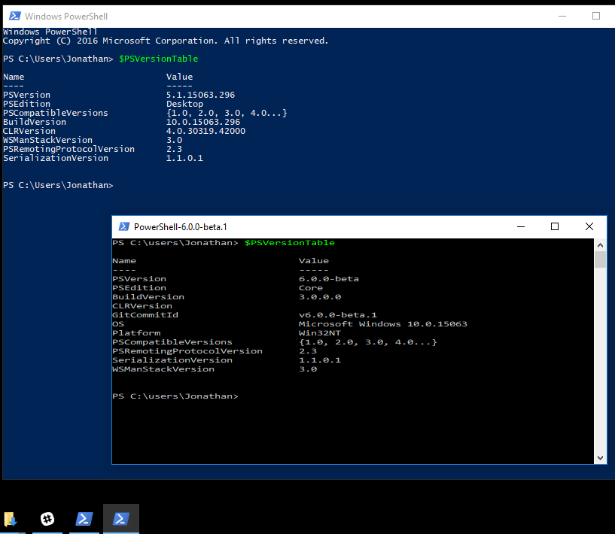
PowerSHell Core 6.0 side by side Windows PowerShell
There are no current plans to ship PowerShell Core 6.0 out of the box in Windows, alongside / instead of Windows PowerShell 5.1.
Just let that sink in……

Slide 23
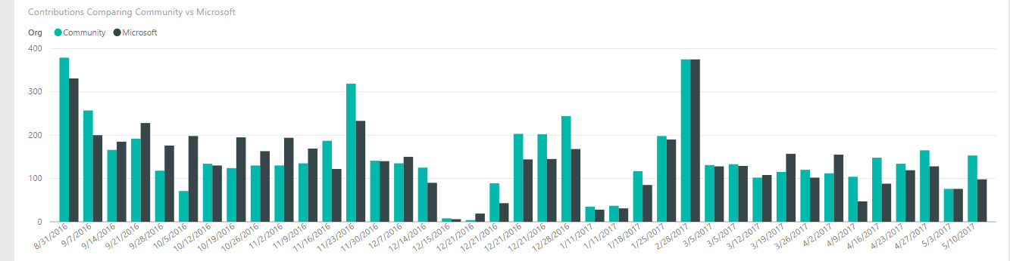
The Community Effect on Development
43% of the pull requests and almost 50% of the issues opened came from the community!
https://blogs.msdn.microsoft.com/powershell/2017/01/31/powershell-open-source-community-dashboard/

Slide 24
You’ll need a process to manage the community contributions though….
https://www.youtube.com/channel/UCMhQH-yJlr4_XHkwNunfMog
https://github.com/PowerShell/PowerShell-RFC/tree/master/CommunityCall

Slide 25

PowerShell Core 6
To achieve this, no features were added!

Slide 26


Slide 28
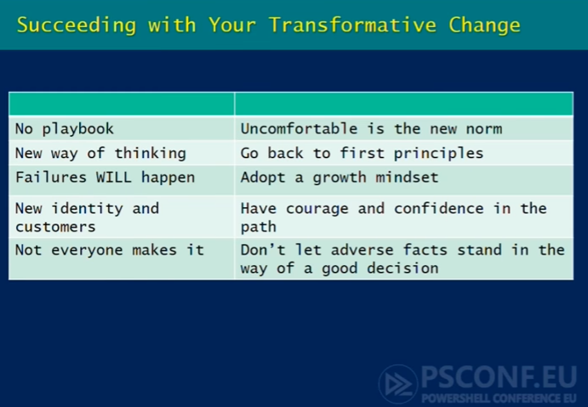

Slide 29
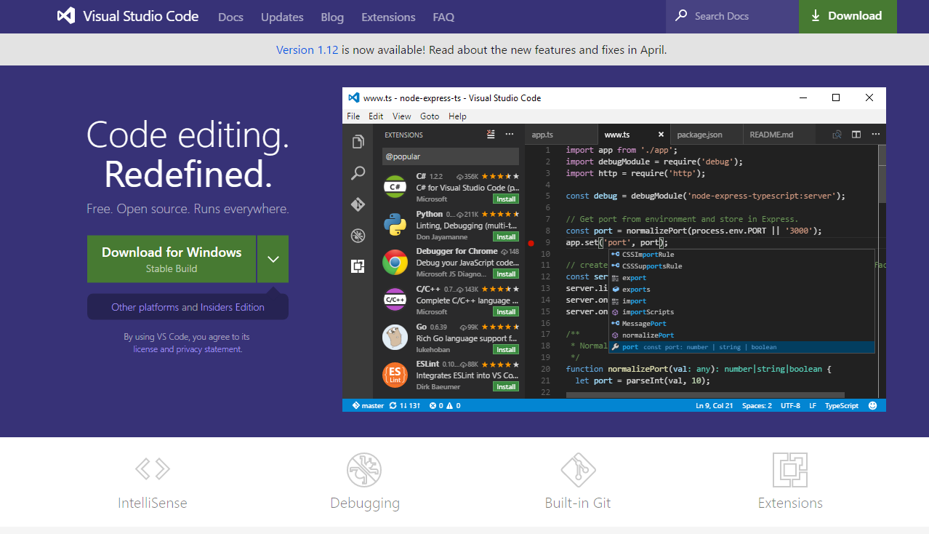
Linux / OS X are First Class Citizens
To do that they need a first class editing experience

Slide 30
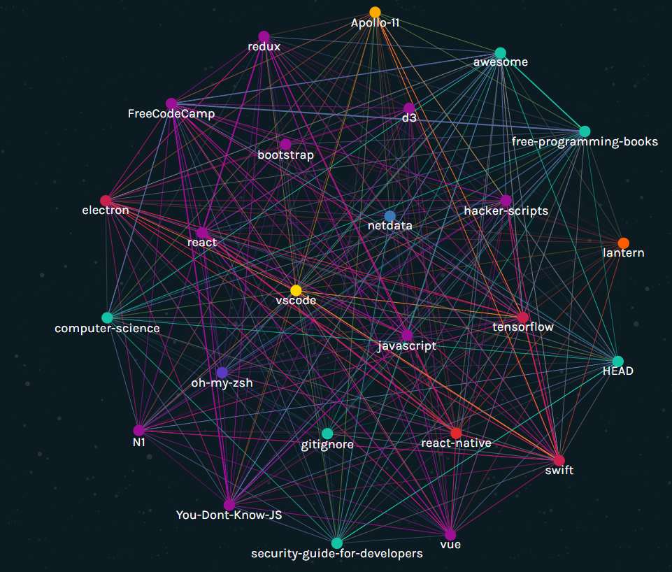
VS Code one of the most starred projects on GitHub in 2016

Slide 31
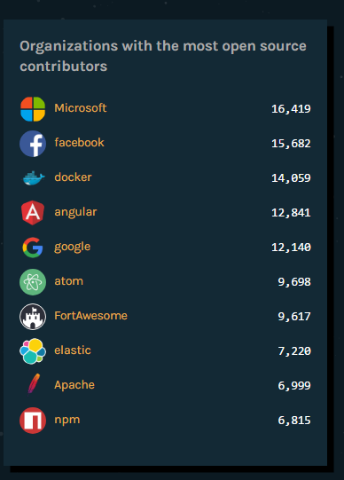
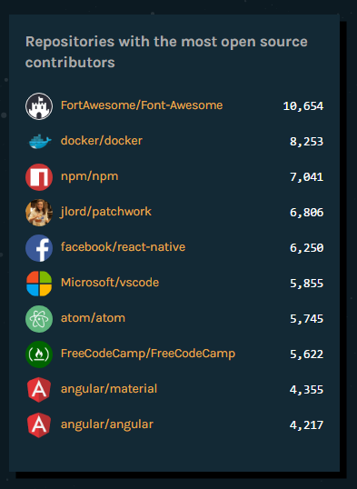
More GitHub 2016 Stats

Slide 32
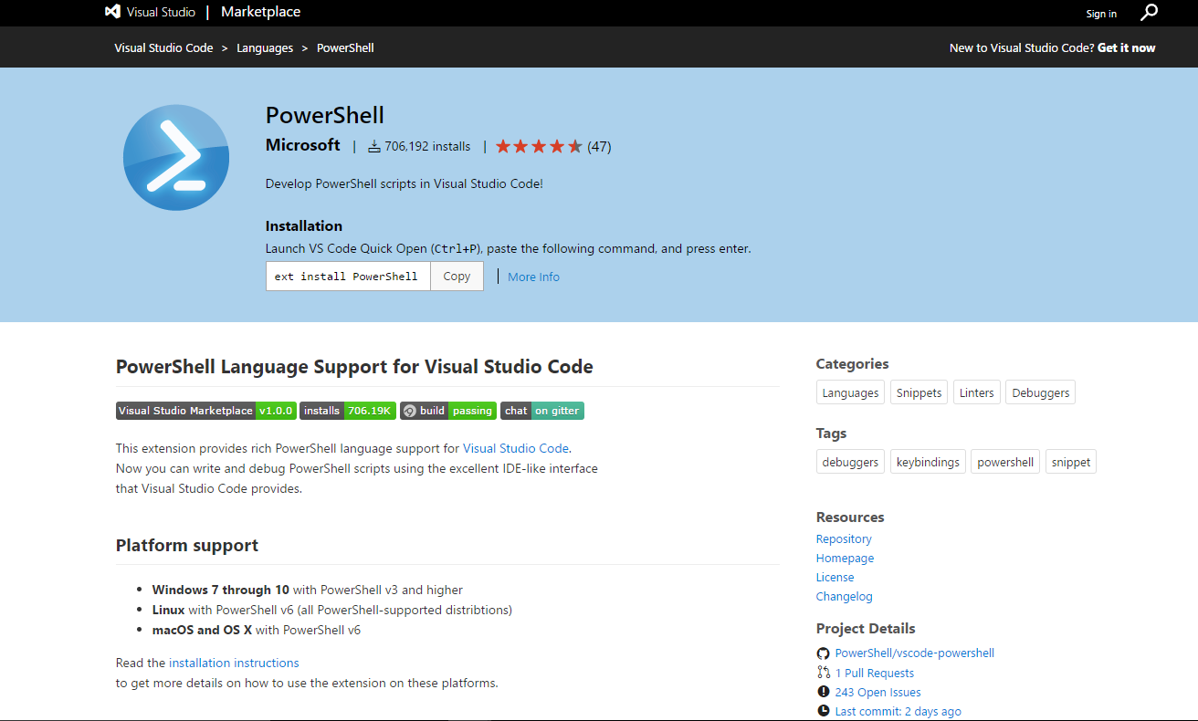
PowerShell Extension for VS Code

Slide 33
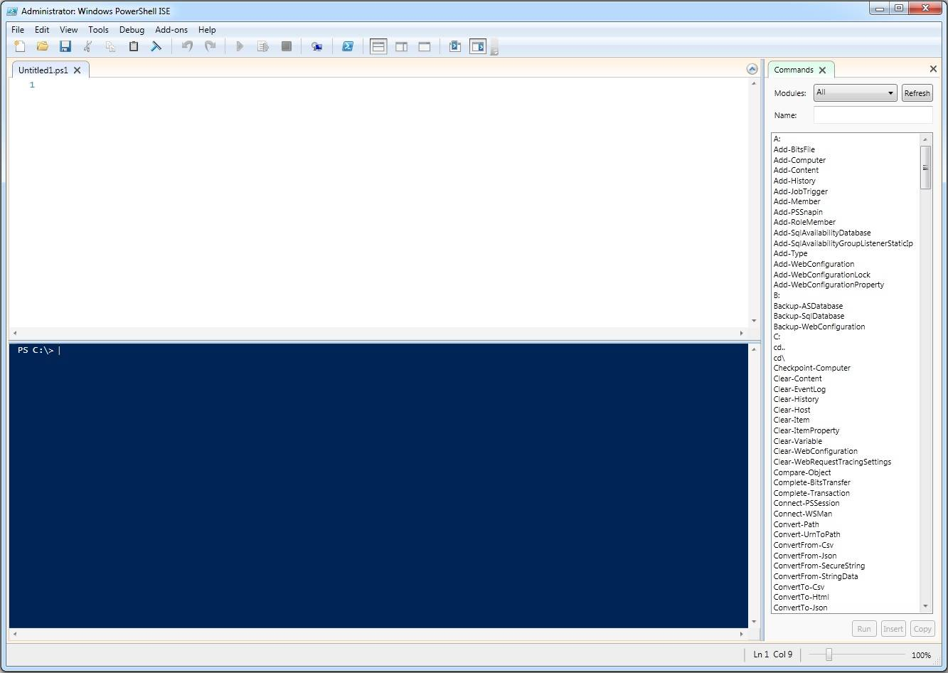
What about the PowerShell ISE?
* Windows only
** Not everybody makes it

Slide 34
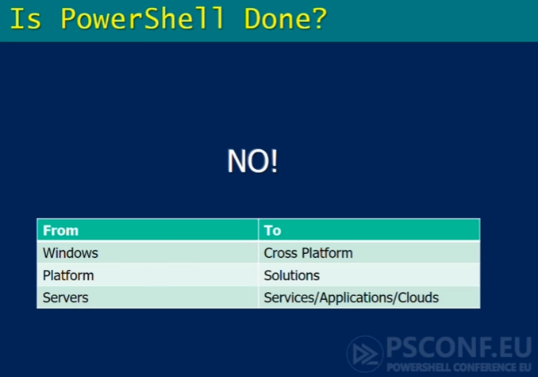

Slide 35


